Slide 1
DESIGN AND IMPLEMENTATION OF A MOBILE APPLICATION THAT CONNECTS BUYERS TO NEARBY SELLERS (FINDNEARME)
Hadiza Aliyu
BU/22A/IT/6545
BSc Software Engineering

Slide 2
Introduction
FindNearMe is a mobile app that connects buyers and nearby sellers, making it easy to discover and trade items within your community. Its AI-powered image recognition and location-based features help customers quickly find products from nearby stores.
Beyond just facilitating transactions, the platform supports environmental sustainability through local commerce while helping boost Nigeria's economy by empowering small businesses.

Slide 3
Problem Statement
Nigeria's digital growth hasn't fully benefited local commerce, with many small businesses struggling to establish an online presence and compete with larger retailers. According to SMEDAN, 85% of SMEs face market access challenges, while consumers have difficulty finding local products. This disconnect not only affects local economies but also leads to increased long-distance shipping and environmental impact.
FindNearMe addresses these challenges by connecting local buyers and sellers through AI-powered image recognition and real-time mapping. The platform helps small businesses increase their visibility, makes it easier for consumers to discover nearby products, and promotes sustainable local commerce, ultimately supporting Nigeria's economic development.

Slide 4
Aims & Objectives
The aim of this project is to design and implement a user-friendly mobile application that connects buyers to nearby sellers. The project is intended to achieve the following objectives:
To integrate AI-powered image recognition to allow users to scan items and find similar products.
To integrate geotagging functionality to accurately connect buyers to nearby sellers.
To develop an in-app messaging system for seamless communication between buyers and sellers.
To design and implement a review and rating system to build trust and reliability among users.

Slide 5
Significance of Study
The FindNearMe mobile application holds significant potential to transform local commerce in Nigeria by providing a comprehensive solution that benefits both consumers and local businesses.
Improving Consumer Convenience: The AI-powered image recognition feature allows consumers to find products easily by simply scanning items, eliminating the need for extensive searches and making shopping more convenient.
Empowering Local Businesses: The app offers a platform for local businesses to showcase their products to a wider audience, which helps them overcome the limitations of traditional brick-and-mortar stores.
Promoting Sustainable Practices: By encouraging local transactions, the app helps reduce the need for long-distance shipping, thereby lowering carbon emissions associated with transportation.
Strengthening Community Ties: The app fosters trust between buyers and sellers through secure transactions, ratings, and reviews, creating a trustworthy marketplace.

Slide 6
Literature Review

Slide 7
Study | Focus | Key Findings | Strengths | Limitations
Zhu et al. (2017) | Image recognition in e-commerce | - Survey of deep learning methods for image recognition - Discussion of CNNs and R-CNNs for product classification | Directly applicable to image recognition and matching for product search | - Limited focus on mobile applications - Does not address real-time performance issues
Yue et al. (2019) | Mobile visual search | - Demonstration of efficient large-scale mobile visual product search - Low-latency, high-accuracy results | Informs implementation of image-based product discovery on mobile platforms | Focused on large-scale applications, may need adaptation for local markets
Dhar & Varshney (2011) | Location-based services | - Overview of LBS components and technologies - Discussion of business models for mobile LBS | Provides foundation for location-based search and interactive maps | Older study, may not reflect latest technological advancements
Bao et al. (2015) | Location-aware recommender systems | - Proposal of a system leveraging geographical information and user preferences - Application to POI recommendations | Directly applicable to location-based search and product recommendations | - Focused on social networks, may need adaptation for marketplace context

Slide 8
Roig-Tierno et al. (2013) | GIS in retail | - Demonstration of GIS use in retail site location decisions - Importance of spatial analysis in understanding market dynamics | Informs design of location-based search and mapping features | Focused on business decision-making rather than consumer applications
Hamari et al. (2016) | Sharing economy motivations | - Identification of key factors driving participation in sharing economy - Insights into user motivations | Informs design of seller and buyer accounts, profiles, and overall platform engagement | Broad focus on sharing economy, may need specific application to local marketplaces
Zervas et al. (2017) | Economic impact of P2P platforms | - Analysis of Airbnb's impact on hotel industry - Demonstration of P2P platforms' disruptive potential | Provides context for potential economic impact of FindNearMe on local commerce | Focused on hospitality sector, may need adaptation for retail context
Masden et al. (2014) | Community social media scaling | - Exploration of challenges in scaling local social media platforms - Insights into community engagement | Informs development of in-app messaging and community features | Focused on social media rather than marketplaces, may need adaptation

Slide 9
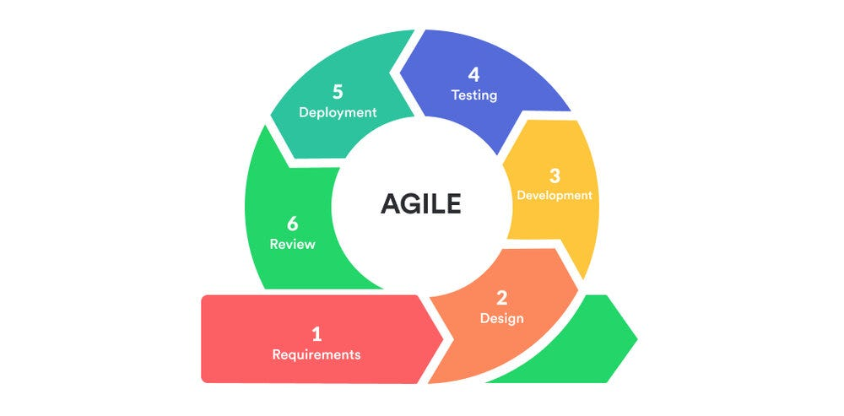
Adopted Methodology
The Agile methodology is particularly well-suited for FindNearMe due to its emphasis on flexibility, customer collaboration, and iterative progress. Agile allows for rapid adjustments based on user feedback, making it ideal for applications where requirements may evolve during development.
Figure 1: Agile Methodology (Jason, J, 2022).

Slide 10
Technologies Used
The FindNearMe app is built using Expo (React Native) for the frontend with Tailwind CSS styling. The backend infrastructure leverages Supabase, an open-source Firebase alternative that provides PostgreSQL database, authentication, real-time features, and storage through an easy-to-use API interface. For its advanced features, the app uses Google's MobileNet neural network (via TensorFlow.js) for image recognition and the Open Street Maps for location services.

Slide 11
Functional Requirements
Req. No. | Description
FR1 | Users must be able to create an account using email or phone number
FR2 | Users must be able to create and edit their profiles and sellers must be able to manage their product listings.
FR3 | Users must be able to search for products using keywords, categories or image-based searches using AI-powered image recognition.
FR4 | Users must be able to view product details, including pricing and seller information.
FR5 | The app must provide users with location-based search results using GPS.
FR6 | Users must be able to communicate with sellers through in-app messaging.
FR7 | Users must be able to leave reviews and ratings for products and sellers.
FR8 | Admins must be able to manage user accounts and product listings.

Slide 12
Non-Functional Requirements
Req. No. | Description
NFR1 | The application should load fast under normal network conditions.
NFR2 | The system should support up to 1000 concurrent users without degradation in performance.
NFR3 | User data should be encrypted both in transit and at rest; complying with relevant data protection regulations.
NFR4 | The app should provide a seamless onboarding experience for new users.
NFR5 | The application should function correctly across various devices.
NFR6 | Code should be modular and well-documented to facilitate future updates.

Slide 13
System Design

Slide 14
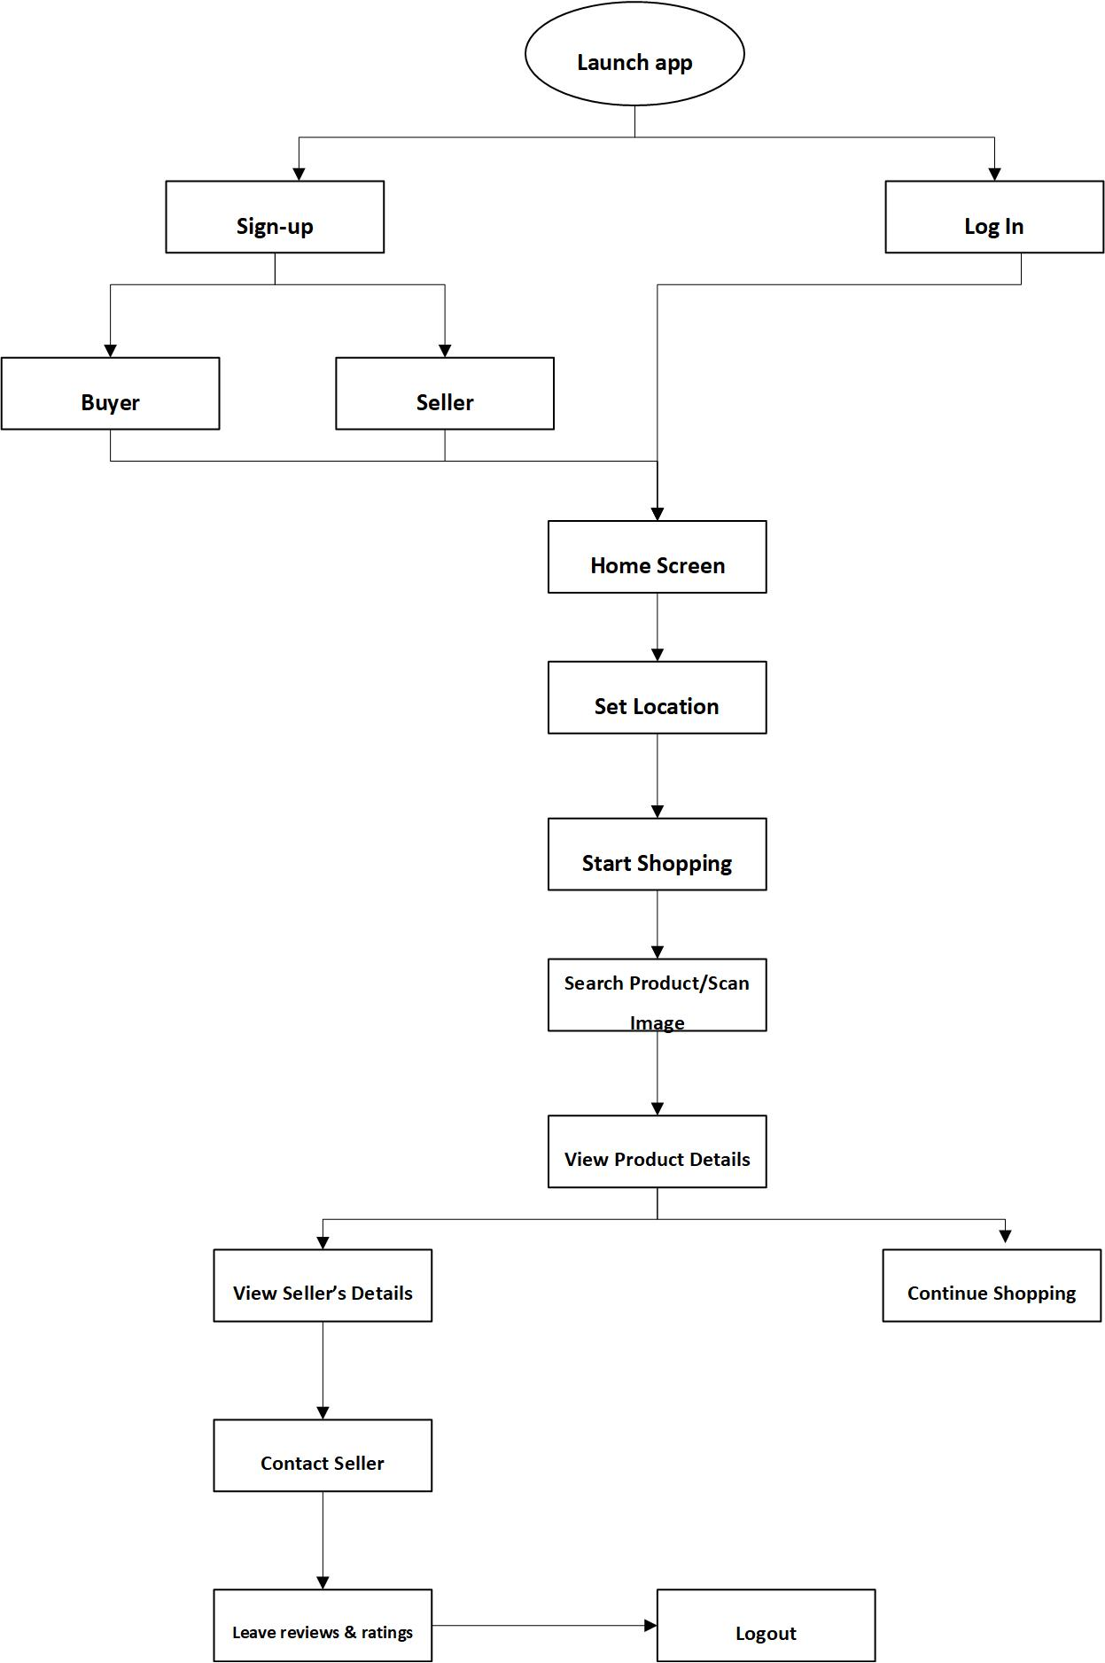
Application Architecture

Slide 15
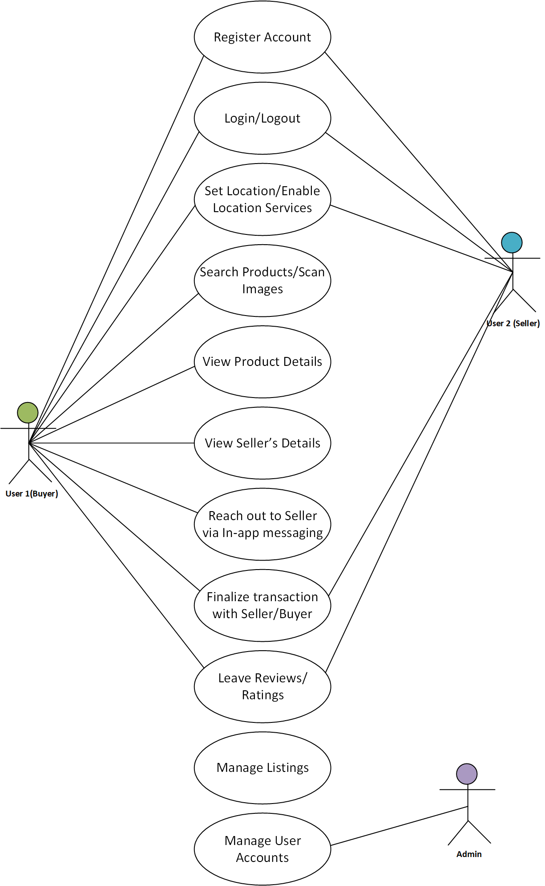
Use Case Diagram

Slide 16
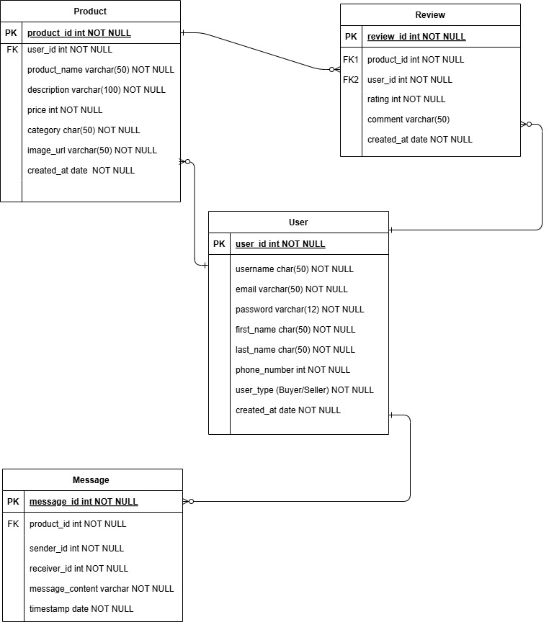
Entity Relationship Diagram

Slide 17
Test Plans
Test Plan ID | TP-FNM-001
Test Plan Name | FindNearMe Test Plan
Version | 1.0
Date | 16/11/2024
Author | Hadiza Aliyu
Objective | The primary objectives of this test plan are to: Verify that all features of the FindNearMe application function as intended. Identify and resolve defects before the application is released to users. Ensure that the application meets performance, security, and usability standards.
Scope | The scope of testing includes: Functional Testing Usability Testing Performance Testing Security Testing Compatibility Testing (across devices and operating systems)
Test Strategy | The testing strategy will encompass various types of testing to ensure comprehensive coverage: Functional Testing: Validate that all features work according to requirements. Usability Testing: Assess user experience and interface design. Performance Testing: Evaluate the application's responsiveness under load. Security Testing: Identify vulnerabilities and ensure data protection. Compatibility Testing: Test the application on different devices, screen sizes, and operating systems.

Slide 18
Conclusion
In conclusion, FindNearMe addresses several key problems faced by both buyers and sellers in local commerce. For buyers, the app solves the difficulty in finding specific items locally by using AI-powered image recognition, allowing users to find exact or similar items nearby simply by taking a photo. For sellers, FindNearMe increases visibility and reach among local buyers actively searching for their products, connecting them with a relevant audience and boosting sales. For the community, FindNearMe supports local businesses and the economy by connecting local buyers and sellers, promoting small businesses, and boosting local commerce.

Slide 19
References
Bao, J., Zheng, Y., Wilkie, D., & Mokbel, M. (2015). Recommendations in location-based social networks: A survey. GeoInformatica, 19(3), 525-565.https://doi.org/10.1007/s10707-014- 0220-8
Dhar, S., & Varshney, U. (2011). Challenges and business models for mobile location-based services and advertising. Communications of the ACM, 54 (5), 121-128. https://doi.org/10.1145/1941487.1941515
Hamari, J., Sjöklint, M., & Ukkonen, A. (2016). The sharing economy: Why people participate in collaborative consumption. Journal of the Association for Information Science and Technology, 67(9), 2047-2059. https://doi.org/10.1002/asi.23552
Masden, C. A., Grevet, C., Grinter, R. E., Gilbert, E., & Edwards, W.K. (2014). Tensions in scaling-up community social media: a multi-neighborhood study of Nextdoor. Proceedings of the SIGCHI Conference on Human Factors in Computing Systems, 3239 -3248.
Roig-Tierno, N., Baviera-Puig, A., Buitrago-Vera, J., & Mas-Verdu, F. (2013). The retail site location decision process using GIS and the analytical hierarchy process. Applied Geography, 40 ,191 -198.doi:10 .1016/j.apgeog .2013 .03 .005
Yue, X., Quan, C., Ma, C., Zhu, L., Chen, T., Kan, W., Pang, Y., & Liu, Y. (2019). A deep learning approach for efficient large-scale mobile visual product search. Knowledge-Based Systems, 163 ,588 -597.doi:10 .1016/j.knosys .2018 .09 .022

Slide 20
Zervas, G., Proserpio, D., & Byers, J.W. (2017). The rise of the sharing economy: Estimating the impact of Airbnb on the hotel industry. Journal of Marketing Research, 54(5),687 -705.
Zhu, L., Yang, Y., Huang, Y., & Wang, W. (2017). A study on deep learning for e-commerce image recognition. Proceedings of the 2017 International Conference on Deep Learning Technologies, 6 -10. doi:10 .1145/3094243 .3094258

